Slide 1
Speeding up Generalized Fuzzy k-Means Clustering Using m Nearest Cluster Centers Algorithm on GPU
Student：Dinh-Trung Vu
Advisor：Zone-Chang Lai

Slide 2
OUTlINE
Introduction
PGFKM model
Updating membership step
Calculating new centroids step
Checking convergence step
Experimental results
Conclusion and Future work

Slide 3
introduction
GFKM: less computing time, better clustering quality than FKM,
The optimal value of M is 2 → the better clustering results,
Size, dimensionality grow → GFKM’s running time grows,
Focus on the size of data set,
Implement parallel GFKM (PGFKM) on a GPU,
PGFKM : 3 to 18 times faster than the optimized CPU code.
Notes:
Average speedup is about seven to ten times

Slide 4
OUTlINE
Introduction
PGFKM model
Updating membership step
Calculating new centroids step
Checking convergence step
Experimental results
Conclusion and Future work

Slide 5
PGFKM MODEL
CPU
GPU
Initialize Centroids
Update Membership
Small data set
Calculate new Centroids
Large data set
Calculate new Centroids
Left small data blocks
Check Convergence
No
Results
Yes

Slide 6
OUTlINE
Introduction
PGFKM model
Updating membership step
Calculating new centroids step
Checking convergence step
Experimental results
Conclusion and Future work

Slide 7
Updating membership on CPU
DNNT : M nearest distances responding to NNT_{i}
For each data point X_{i}
For each centroid C_{j}
Update membership for data point X_{i}
Calculate distance d(X_{i}, C_{j})
Update NNT_{i} and DNNT

Slide 8
Updating membership on GPU
N data points → N threads working in parallel,
Each thread :
loads a data point → on-chip registers,
reads same centroids in shared memory (SM) : writes < 5 values → shared memory,
reads same centroids in global memory (GM).

Slide 9
Updating membership on GPU
gridDim = N / blockDim
Thread T_{i}
i = blockIdx.x * blockDim + threadIdx.x;
For each C_{j} in GM
Load X_{i} → on-chip registers
Calculate distance d(X_{i}, C_{j})
Update memberships for X_{i}
Update NNT_{i} and DNNT

Slide 10
Updating membership on GPU
gridDim = N / blockDim
Thread T_{i}
i = blockIdx.x * blockDim + threadIdx.x
Load centroid
GM → SM → synchronize threads
For each C_{j} in SM
Calculate distance d(X_{i}, C_{j})
Load X_{i} → on-chip registers
Update NNT_{i} and DNNT
Update memberships for X_{i}

Slide 11
OUTlINE
Introduction
PGFKM model
Updating membership step
Calculating new centroids step
Checking convergence step
Experimental results
Conclusion and Future work

Slide 12
Calculating new centroids on CPU
N is small : number of active threads in parallel is small → GPU is inefficient → CPU is still used,
The computational complexity : O(NMd + kd).

Slide 13
Calculating new centroids on CPU
SumU_{j} : sum of memberships of C_{j}
For each X_{i}
For each centroid index j in NNT_{i}
For each C_{j}
C_{j} = C_{j} + U’_{i,j}^{q} * X_{i}
C_{j} = C_{j} / SumU_{j}
SumU_{j} = SumU_{j} + U’_{i,j}^{q}

Slide 14
Calculating new centroids on GPU
N is large, k is close to M : using equation of FKM,
The computational complexity : O(Nkd + kd),
Having un-coalesced data access,
To achieve coalesced data access, using cuBLAS library:
transpose data points from N×d to d×N,
transpose memberships from N×k to k×N.

Slide 15
Calculating new centroids on GPU
Un-coalesced data access

Slide 16
Calculating new centroids on GPU
Coalesced data access

Slide 17
Calculating new centroids on GPU
Reduce U_{i,j}^{q} for the jth cluster on GPU,
Reduce U_{i,j}^{q} * X_{i} for the jth cluster and xth dimension on GPU,
Executed concurrently or interleaved in six different streams,
Small output block sums: reduced very fast on CPUs.

Slide 18
Calculating new centroids on GPU
CPU
GPU
Transpose data points and memberships
Small block sums
For j = 1 to k
Reduce new centroids
Stream #1 reduces U_{i,j}^{q}
For x = 1 to d
Stream #(x mod 5 + 1) reduces U_{i,j}^{q} * X_{i}

Slide 19
Calculating new centroids on GPU
N is large, k is not close to M : using equation of GFKM,
The computational complexity : O(NMd + kd),
Reduce un-coalesced data accesses : transpose data points from N×d to d×N,
Reduce un-coalesced membership accesses : sort NNT with
keys : cluster indices,
values : point indices, memberships.

Slide 20
Calculating new centroids on GPU
Sorting array NNT has two scenarios :
(1) using GPU-based counting sort algorithm,
(2) using stable sort by keys of Thrust library.
Scenario (1) : histogram of NNT is calculated first.

Slide 21
Calculating new centroids on GPU
Histogram write conflicts : a lots of threads with the same cluster index increase the histogram array

Slide 22
Calculating new centroids on GPU
Counting sort using atomic functions
Calculating histogram of NNT
(gridDim = (N * M) / blockDim)
Thread T_{i}
atomicAdd(histogram(NNT(i)), 1)
Thread T₀
For i = 1 to k
scan(i + 1) = scan(i) + histo(i)
Calculating starting index for each cluster
Gathering memberships and point indices
(gridDim = (N * M) / blockDim)
Thread T_{i}
idx = atomicAdd(scan(NNT(i)), 1)
sortedMemberships(idx) = U(i)
sortedPointIndices(idx) = i/M

Slide 23
Calculating new centroids on GPU
Counting sort using atomic functions: not ensure the stability of point indices in each cluster → crossover data accesses of threads reduce performance.

Slide 24
Calculating new centroids on GPU
Un-crossover data accesses : use stable sort by keys of Thrust library in CUDA Toolkit.

Slide 25
Calculating new centroids on GPU
CPU
GPU
Transpose data points, sort array NNT, gather memberships and point indices
Small block sums
For j = 1 to k
Reduce
new centroids
Stream #1 reduces U’_{i,l}^{q} (U’_{i,l}^{q} ∈ cluster #j)
For x = 1 to d
Stream #(x mod 5 + 1) reduces
U’_{i,l}^{q} * X_{i} (X_{i} ∈ cluster #j, dimension x)

Slide 26
OUTlINE
Introduction
PGFKM model
Updating membership step
Calculating new centroids step
Checking convergence step
Experimental results
Conclusion and Future work

Slide 27
Checking convergence
Occupying a very small quota → can design on CPU or GPU,
On GPU:
each thread executes one dimensional of centroid,
each thread block executes for one centroid.

Slide 28
OUTlINE
Introduction
PGFKM model
Updating membership step
Calculating new centroids step
Checking convergence step
Experimental results
Conclusion and Future work

Slide 29
Experimental Results
CUDA version 7.0 : 64 bit
NVIDIA GeForce GTX 760 GPU :
six SIMD multi-processors × 192, 1.5 GHz, 2GB, 192.2 GB/s
Intel(R) Core(TM) i5-4690 CPU :
four cores, 3.5 GHz, 8GB, 25.6 GB/s

Slide 30
Experimental Results
Four versions for calculating new centroids step:
Version 1 : on CPU,
Version 2 : on GPU using equation of FKM,
Version 3 : on GPU using counting sort,
Version 4 : on GPU using Thrust stable sort by key.

Slide 31
Experimental Results
First test : speedup on a real data set : “Lena,” “Baboon,” and “Peppers”
N = 49152, d = 16, M = 2, k = 8, ε = 1e-8, maximum iterations = 200.
GFKM method | Speedup of PGFKM
 | Version 1 | Version 2 | Version 3 | Version 4
Updating memberships | 10.5 | 9.95 | 11.38 | 11.41
Calculating new centroids | 1.14 | 1.35 | 1.52 | 0.98
Checking convergence | 1.00 | 1.00 | 1.00 | 1.00
Total after 200 iterations | 6.14 | 6.40 | 7.32 | 5.92

Slide 32
Experimental Results
Second test : changing speedup with various N on “poker” data set with d = 10, M = 2, k = 10, ε = 1e-8, and maximum iterations = 200.

Slide 33
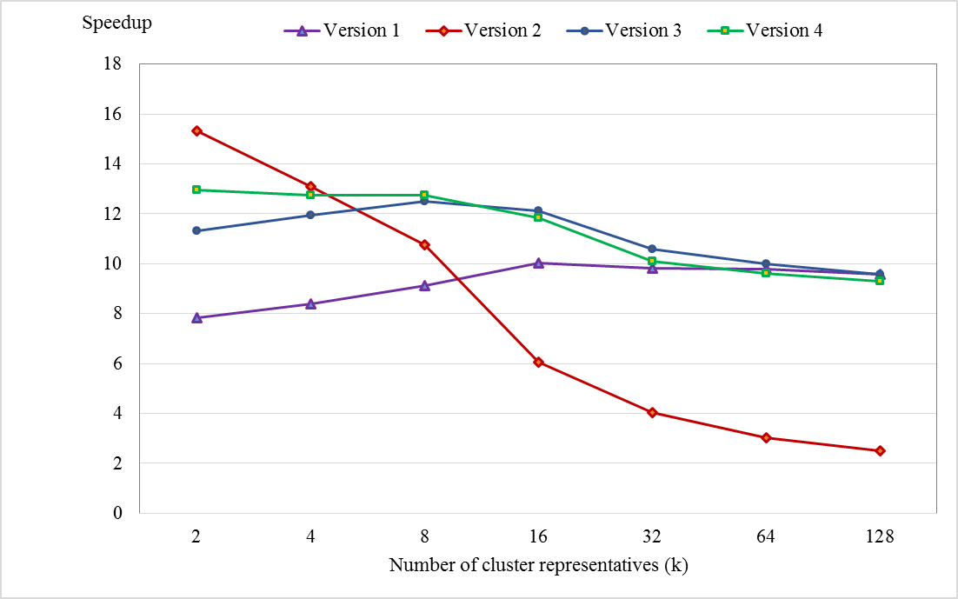
Experimental Results
Third test : changing speedup with various k on “poker” data set with N = 1025100, d = 10, M = 2, ε = 1e-8, maximum iterations = 200.

Slide 34
Experimental Results
Fourth test : changing speedup with various d on “Synthetic” data set with N = 491520, M = 2, k = 8, ε = 1e-8, and maximum iterations = 200.

Slide 35
OUTlINE
Introduction
PGFKM model
Updating membership step
Calculating new centroids step
Checking convergence step
Experimental results
Conclusion and Future work

Slide 36
Conclusion and future work
The better speedups : the larger N, smaller d and k
High-dimensional : data point can not be loaded into registers → reduce performance
In future, calculate the temporary distance and store in the on-chip registers by :
loading the data → SM, tile by tile,
adopting the idea of parallel matrix multiplication.
Notes:
Average speedup is about seven to ten times

Slide 37


Slide 38
Thank You

